Slide 1

Smart Home Automation based on temperature sensor and Arduino as the master controller.
Supervised by:
Dr. Sabah Mohammed
Presented by:
Ankit Raj
Department of Computer Science

Slide 2
AGENDA .....
Introduction
Project Goal
Methodology
Design
Challenges faced
Implementation
Live Demo
Results
Conclusion
Future Developments
References

Slide 3
INTRODUCTION

Slide 4
The Internet of Things (IoT) is a phenomenon that is rapidly gaining attention in the case of modern wireless telecommunications. The basic idea of this concept is the persistent existence around us of a variety of things or objects – such as Radio-Frequency Identification (RFID) tags, sensors, actuators, mobile phones, etc. – which, through unique addressing schemes, are able to interact with each other and cooperate with their neighbors to reach common goals [1].
Smart-Home automation is an IoT concept that provides a way that all devices and appliances will be networked together to provide us with seamless control over all aspects of our home and more. It is a concept of automation of housework or household activity. Home automation has emerged quickly and is already in the trend nowadays. Increase in comfort and more rational use of energy and other resources are its main benefits. Generally, the home automation is very complex and carries a high cost along with it. Thus, an attempt is made to keep it less complex and cost effective by using Arduino as master controller.

Slide 5
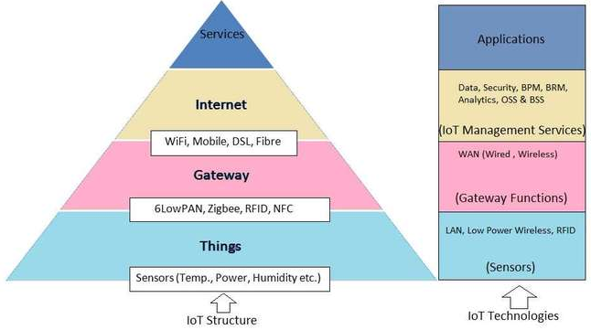
IOT architecture includes different categories of technologies supporting IOT. It works to show how various technologies relate to each other and communicates the scalability, modularity and configuration of IOT deployments in different scenarios. Below mentioned is the diagram that shows IOT architecture. [2]

Slide 6
Project Goal

Slide 7
The main goal of this project is to create a home automation system that interacts with sensors and actuators wirelessly, using Arduino UNO as the master controller.

Slide 8
METHODOLOGY

Slide 9
METHODOLOGY
In order to achieve the project goal, it is necessary for Arduino board to interact wirelessly with the sensors and actuators.
To make things a bit simple, we would be using WeMos D1 (R2).
WeMos D1 is an Arduino UNO compatible WiFi board based on ESP8266EX. It has following feature:-
11 digital input/output pins, all pins have interrupt/pwm/I2C/one-wire supported(except for D0)
1 analog input(3.2V max input)
Micro USB connection
Power jack, 9-24V power input.
Compatible with Arduino
Compatible with nodemcu

Slide 10
METHODOLOGY contd…
In order to facilitate radio feature with Arduino UNO, NRF24L01 could be used.
NRF24L01 consists of :-
a fully integrated frequency synthesizer
a power amplifier
a crystal oscillator
a demodulator
modulator
Enhanced ShockBurst™ protocol engine
Another alternative is using ESP8266.

Slide 11
METHODOLOGY contd…
There is numerous ways to communicate with IoT. Other than wired connection following are the ways of communicating with IoT:
WiFi
Radio or Remote.
In order to achieve the successful communication, various techniques are required, which are as follows:
SPI
Serial Port
I²C

Slide 12
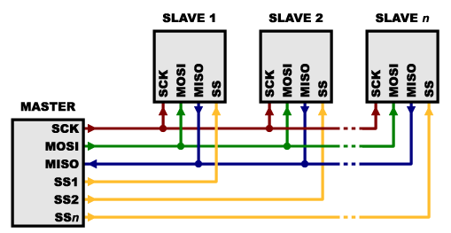
METHODOLOGY contd…
SPI
Serial Peripheral Interface (SPI) is an interface bus that helps to send data between microcontrollers and small peripherals. This interface uses isolated clock and data lines, along with a select line to choose the device one wishes to communicate with [3].
Figure : SPI Master-Slave concept

Slide 13
METHODOLOGY contd…
Serial Port
A serial communication interface through which information transfers in or out one bit at a time is termed as serial port. The asynchronous port (generally with TX and RX lines), which is most common port, has no control over data transmission and could not guarantee that both sides are running at precisely the same rate.
There could be an issue when two systems with a little different clock try to communicate with each other as computers normally rely on everything being synchronized to a single “clock”.
To solve this problem, asynchronous serial connections add extra start and stop bits to each byte that help the receiver sync up to data as it arrives. There should also be agreement on same transmission speed in advance. Slight differences in the transmission rate aren’t a problem because the receiver re-syncs at the start of each byte.

Slide 14
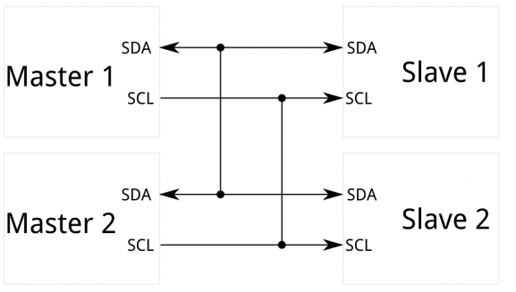
METHODOLOGY contd…
I²C
The Inter-integrated Circuit (I2C) Protocol [4] is a protocol that provides communication between multiple chips (digital integrated circuits) with one or more master chips. I2C requires only two wires, as asynchronous serial, but those two wires can hold up to 1008 slave devices. Additionally, unlike SPI, I2C can support a multi-master framework, enabling in excess of one master to communicate with all devices on the transport (in spite of the fact that the master devices can't communicate with each other over the communication bus and should alternate utilizing the communication lines).
Figure : I2C Master-Slave concept

Slide 15
METHODOLOGY contd…
Standard Libraries Used:
SPI - for communicating with devices using the Serial Peripheral Interface (SPI) Bus
SoftwareSerial - for serial communication on any digital pins.
WiFi - for connecting to the internet using the Arduino WiFi shield
Custom library for this project
ESP8266WiFi – This library is used to enable ESP8266 micro-chip on the board that enables the board to connect with the WiFi.
DHT11 - This library is used to enable DHT-11 (temperature & humidity sensor) to interact with the boards and provide the facility to record the values.

Slide 16
METHODOLOGY contd…
There are three modes of this project, described as follows:
Monitoring the sensor values/readings: Arduino enables users to read the sensor values as it convert the analog input signal into digital values. In this case the user would be getting a temperature or voltage value so as to carry out the desired task.
Controlling Actuators: Arduino gateway can trigger various actions through actuators. In this case, based on the values returned from the sensors, various actions would be performed like switching On/Off of LEDs or rotating of servo-motor.
Pushing Notification to User (VIA Text or Tweet): A function of pushing notifications of status of actuators or sensors through text or tweet would also be present so that the user (who is not around) can be updated accordingly about the device-interaction or performance.

Slide 17
METHODOLOGY contd…
Following are the steps to follow in order to validate the concept of methodology:
Upload the code to the respective board, by connecting it to computer (IDE).
After uploading, do the required setup by connecting the sensors, actuators, Arduino as desired.
Disconnect all the connection between the boards and computer and let it work as per the wireless interaction of devices with the board.

Slide 18
DESIGN

Slide 19
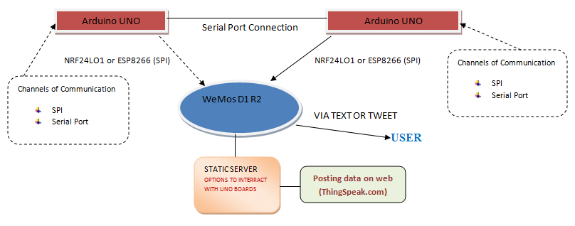

Slide 20
Challenges Faced

Slide 21
Following are the challenges faced while implementing the design:
WeMos D1 R2 not compatible with NRF24L01: To facilitate the WiFi feature in Arduino UNO, NRF24L01 was used but later it was realized that WeMos D1 R2 is not compatible with NRF24L01. Thus, it was switched to ESP-01 to provide ESP8266 enabled Arduino UNO so as to interact with WeMos D1 R2 wirelessly.
ESP-01 does not work properly with 3.3V: ESP8266 works at 3.3V, but ESP-01 has a problem when plugged directly with 3.3V. To overcome this issue a voltage regulator LM317 was used.
ESP-01 not compatible with Esp8266Wifi.h library: Unlike WeMos D1 R2, which has an in-built ESP8266EX chipset, that supports the default ESP8266Wifi library. ESP-01 does not support it. A separate library( in-built Arduino Library), named, WifiUdp.h was used to overcome this issue.

Slide 22
IMPLEMENTATION

Slide 23
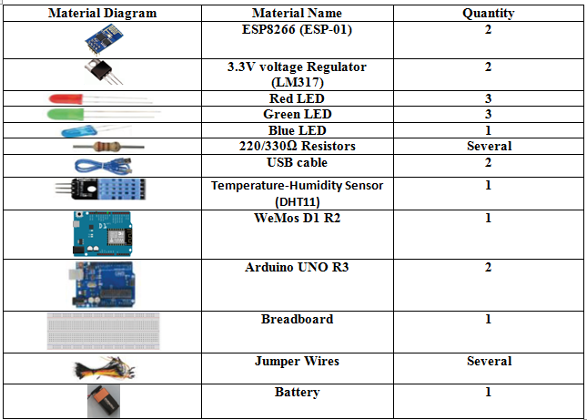
IMPLEMENTATION
This project consists of one sensor – DHT11 (Temperature and Humidity sensor) and various LEDs acting as actuators. Below mentioned are the materials required to achieve the desired goal:

Slide 24
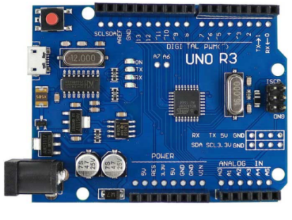
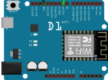
IMPLEMENTATION CONTD..
Details of the major component for this project are as follow:-
Arduiono UNO R3:
Arduino Uno [5] is a microcontroller board based on the ATmega328P.
This project use two of these boards as Console-1 and Console-2 to implement the Phase-I.
WeMos D1 R2:
WeMos D1 R2 is used as a third console in order to implement Phase –II and Phase –III. WeMos D1 is an Arduino UNO compatible WiFi board based on ESP8266EX.

Slide 25
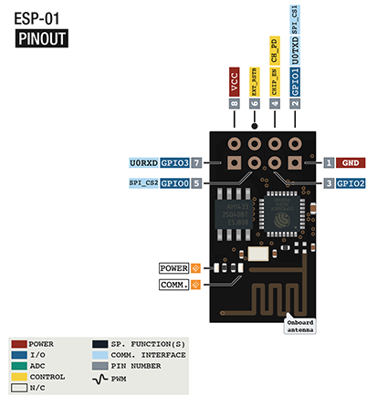
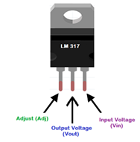
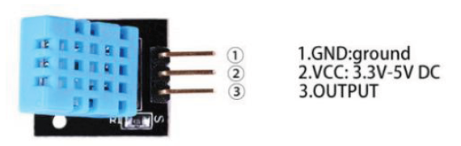
IMPLEMENTATION CONTD..
ESP8266 ESP-01:
ESP-01 is used to enable wireless communication on one of the UNO boards (console-2). It uses a separate 3.3V voltage regulator LM317 (Figure 4.4) as ESP-01 does not support 5V.
DHT-11:
DHT-11 is a temperature and humidity sensor that is a high performance 8-bit microcontroller. It uses 5V power supply to sense, measure and regularly report the relative humidity in air along with temperature.

Slide 26
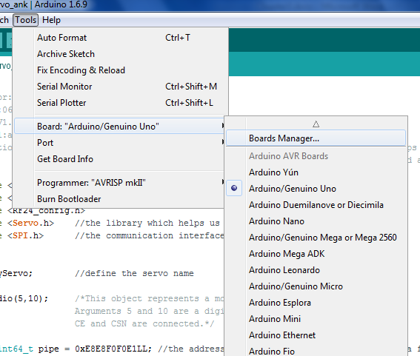
IMPLEMENTATION CONTD..
Preparing the Environment
Install the following as per the instruction on the corresponding site in the same order as below:
Arduino 1.6.9 https://www.arduino.cc/en/Main/OldSoftwareReleases
ESP8266 board - Go under tools – boards <name of currently connected board> - Boards Manager and then search “ESP8266” and select install.

Slide 27
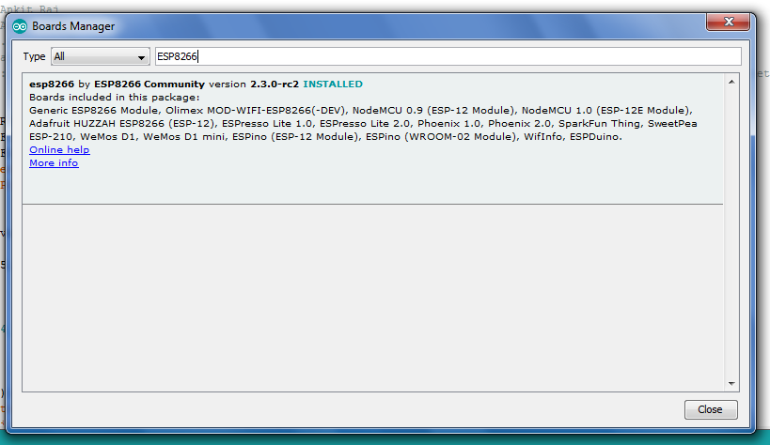
IMPLEMENTATION CONTD..

Slide 28
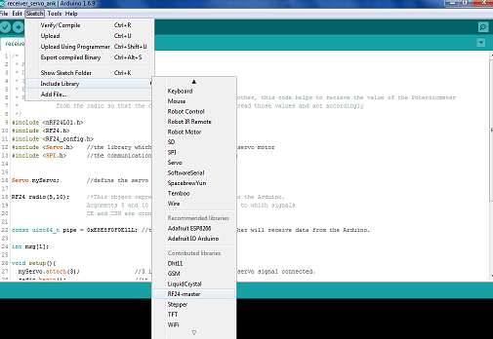
IMPLEMENTATION CONTD..
Attached the required custom libraries –
After adding the custom library by going under
sketch – include library – add .zip Library, one need to include the library to the IDE by going under
>sketch – include library – <name of the custom library> (as shown in figure below)

Slide 29
IMPLEMENTATION CONTD..
Phases of Implementation
Phase I – Two Board Communication:-
Records the temperature and Humidity
Connects to Console -2 Serially
Console-2 acknowledges the data
Console-1 receives the acknowledgement
For enabling the second phase, Console-2 is connected to ESp-01 to transfer the data to Console-3.

Slide 30
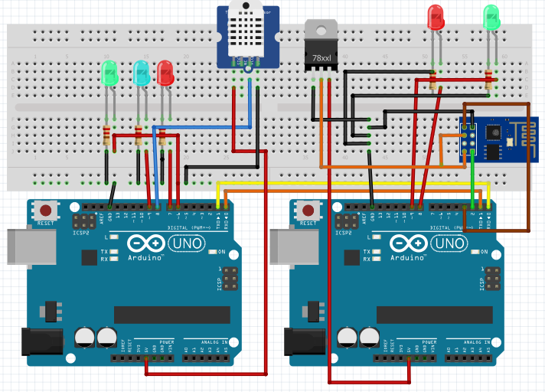
IMPLEMENTATION CONTD..
Following is the connection diagram for Phase I:

Slide 31
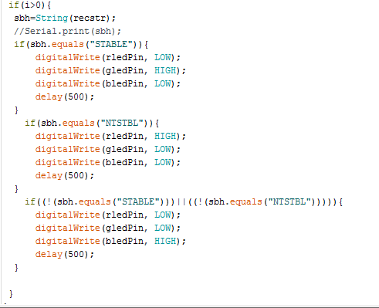
IMPLEMENTATION CONTD..
Phase I concept of acknowledging the data sent from Console 2:

Slide 32
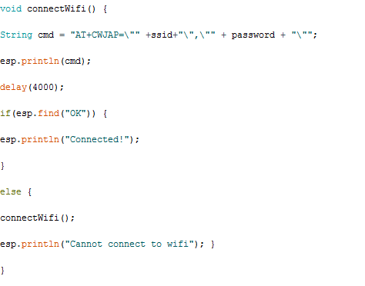
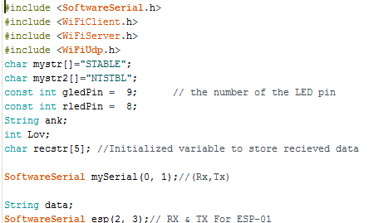
IMPLEMENTATION CONTD..
Libraries Used: DHT11.h and SoftwareSerial.h.
For initiating next phase, WiFiClient.h, WiFiServer.h, WiFiUdp.h, libraries are used.

Slide 33
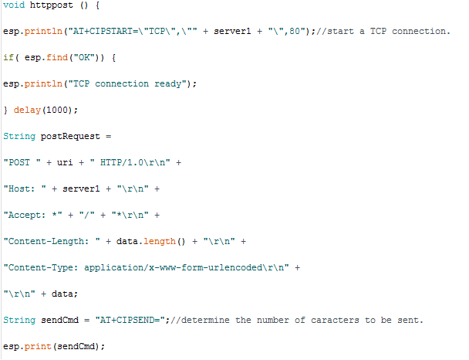
IMPLEMENTATION CONTD..
Console 2 concept of broadcasting Console 1 data received at its end to the static server created by WiFi of home router by console -3:

Slide 34
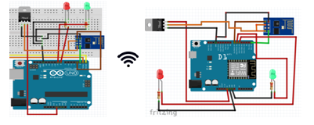
IMPLEMENTATION CONTD..
Phase II – Three Board Communication
Console - 2 transmits the data to Console -3 via ESP-01
Console – 3 receives the data from Console-2 and acknowledges through actuators.
Console -3 creates a static server over the connected WiFi to give a user interface.
Following is the connection diagram:

Slide 35
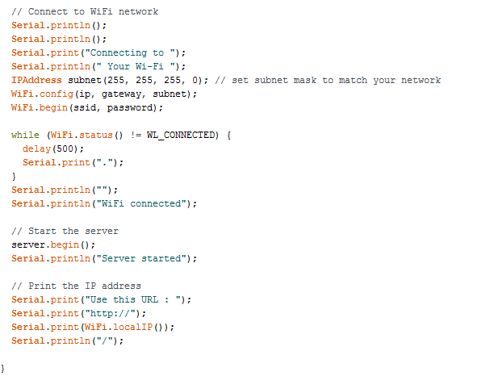
IMPLEMENTATION CONTD..
Libraries Used: ESP8266WiFi.h, WiFiClient.h, WiFiServer.h, WiFiUdp.h and SoftwareSerial.h.
Console 3 concept of creating a static local server is as follows:

Slide 36
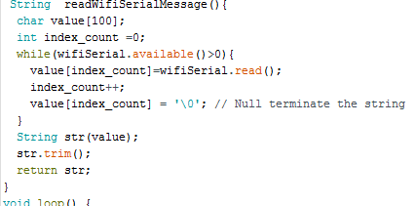
IMPLEMENTATION CONTD..
Following is the Console 3 concept of reading the data sent from Console 2 wirelessly using ESP-01:

Slide 37
IMPLEMENTATION CONTD..
Phase III – Alerting the user
Console-3 attempts to connect with ThingSpeak.com
Posting the temperature and humidity data on the website.
Alerting user through Tweets.

Slide 38
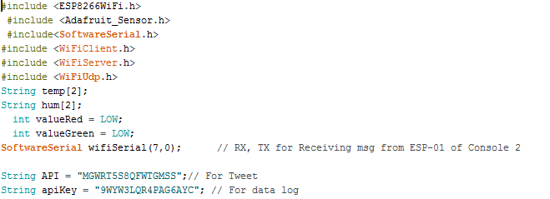
IMPLEMENTATION CONTD..
Following is the Console 3 concept of broadcasting data received from console 2 to the static and Web server including Twitter by using WiFi of home router :

Slide 39
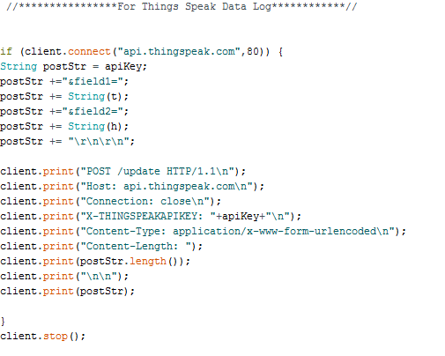
IMPLEMENTATION CONTD..

Slide 40
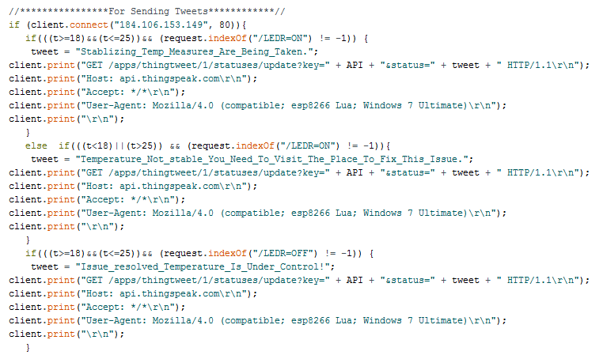
IMPLEMENTATION CONTD..

Slide 41
IMPLEMENTATION CONTD..
Link to Implementation Video:
https://www.amazon.ca/clouddrive/share/7mjMPKnnIZDs04o6bMZsN3imCabguEgWCWE6yGdbXxL

Slide 42
Live Demo …..

Slide 43
Results

Slide 44
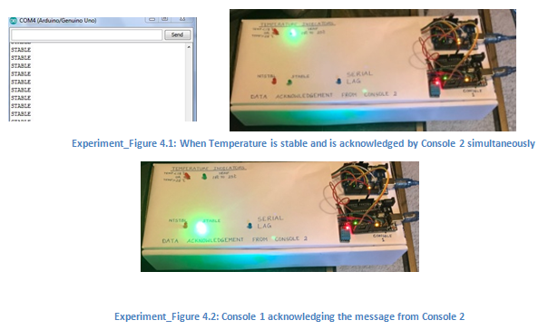
Phase I Results:-

Slide 45
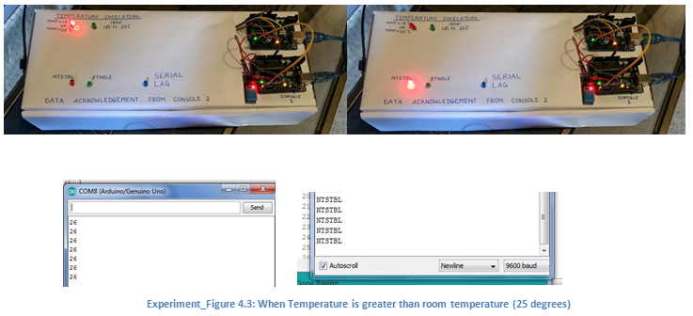
Phase I Results:-

Slide 46
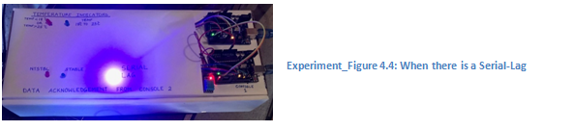
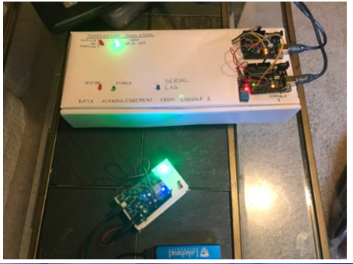
Phase I Results:-
Phase II Results:-

Slide 47
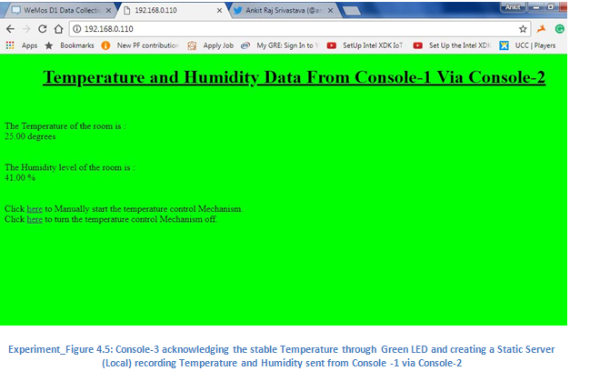
Phase II Results:-

Slide 48
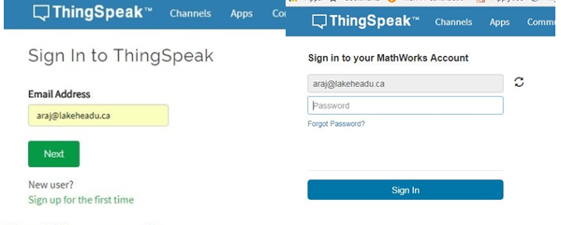
Login Screen for ThingSpeak.com

Slide 49
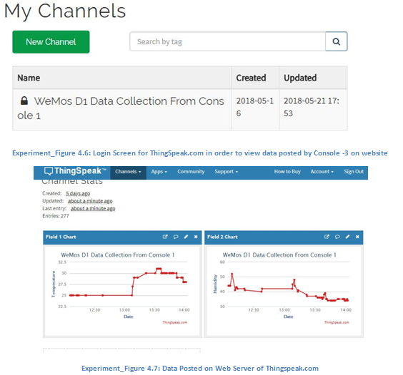
Phase III Results:-

Slide 50
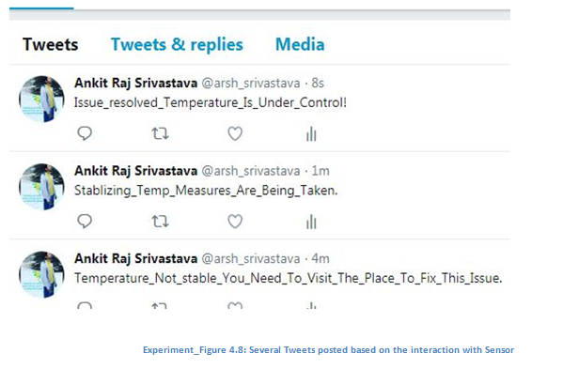
Phase III Results:-

Slide 51
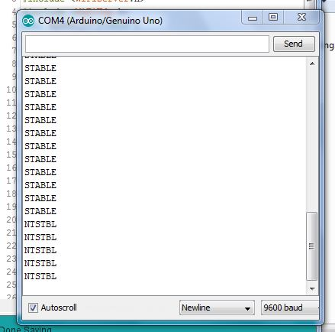
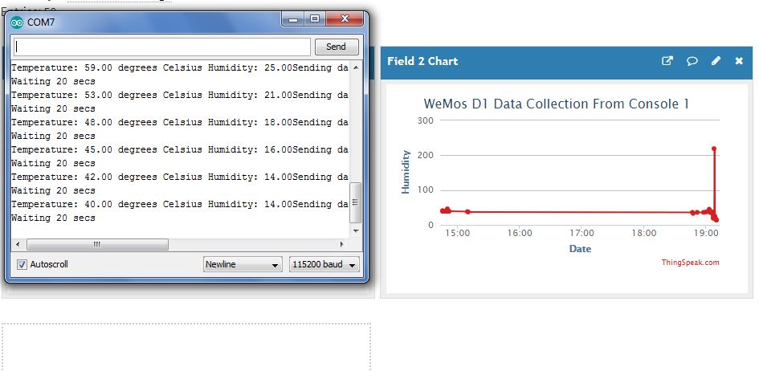
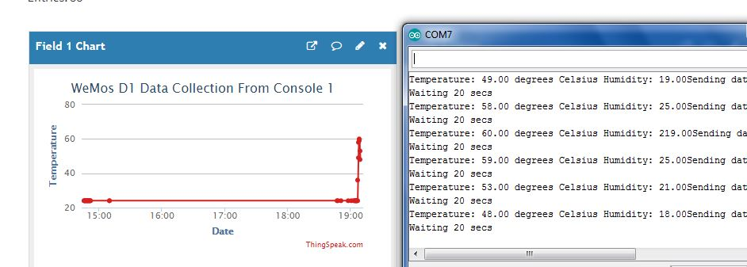
Special Cases:-

Slide 52
CONCLUSION

Slide 53
Building home automation system using Arduino UNO is challenging, as the board itself has a lot of limitation. However, one can still build an efficient system of home automation from UNO boards by using some additional accessories like ESP8266 and WeMos D1 R2 (WiFi enabled Arduino UNO). In this project, ESP-01 is used to facilitate with ESP8266, which is very economical but is the lower version of ESP8266. One can use ESP-12 to overcome the challenges faced in ESP-01, especially with the voltage regulator. WeMos D1 board too offered few challenges as it does not support Radio communication, which in return would have made this project more economical.
Considering all challenges faced, this project is still a good example of creating a smart home automation based on a sensor using Arduino UNO as the master controller.

Slide 54
FUTURE DEVELOPMENTS

Slide 55
In spite of having a limited scope (due to challenges offered by WeMos D1 R2), this project still have a scope of further advancements in future. Following are few:
Global Interaction with Sensors: This project offers to interact with the sensors locally (needs the user to be connected with the home WiFi). However, it also offers the scope of advancement so as to make user capable of interacting with the sensor from anywhere. For instance, user can post Tweet about switching off the lights or any possible actuators.
Adding Home Security: Just like temperature sensors, there are also few bio-metric sensors available in the market which can be incorporated in this project so as to add security feature. For instance, user would be alerted if someone accesses any actuators linked with the sensor without proper authentication.

Slide 56
REFERENCES

Slide 57
References : RESEARCH PAPERS
Giusto, Daniel, Antonio Iera, Giacomo Morabito, and Luigi Atzori, eds. The internet of things: 20th Tyrrhenian workshop on digital communications. Springer Science & Business Media, 2010.
References : WEBSITES
http://www.rfwireless-world.com/images/IoT-structure-and-technologies.jpg
https://learn.sparkfun.com/tutorials/serial-peripheral-interface-spi
https://learn.sparkfun.com/tutorials/i2c
https://store.arduino.cc/usa/arduino-uno-rev3

Slide 58
QUESTIONS ??

Slide 59
Thank You ..!

